Slide 1

Influenza Staffing objectives
Project 2:
During the U.S. flu season, cases rise among vulnerable populations, prompting hospitals to depend on staffing agencies for temporary healthcare workers.
Contains monthly death counts for influenza-related deaths in the united states from 2009 to 2017.
Objectives
Analyze Influenza seasonality
Identify & prioritize states by the proportion of vulnerable population.
Determine when to send staff, and how many to each state.
Methods
Data transformation
Data integration
Data profiling
Statistical analysis & testing
Forecasting and spatial analysis
Data visualization & storytelling.

Slide 2
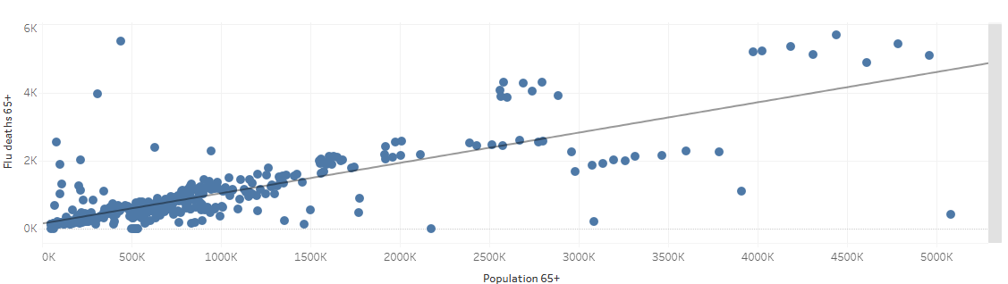
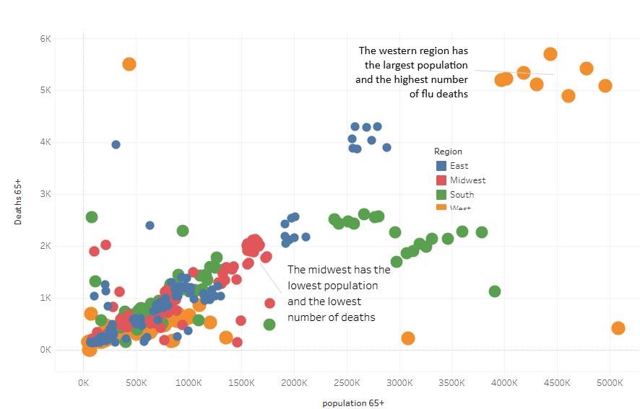
Influenza Analysis
The relationship between the population above 65 and the deaths from the fly have a strong positive correlation, meaning the higher the vulnerable population across each state the higher the death count caused by the flu will be.
Midwest has the lowest of both population and mortalities
West has the highest of both mortalities and population

Slide 3
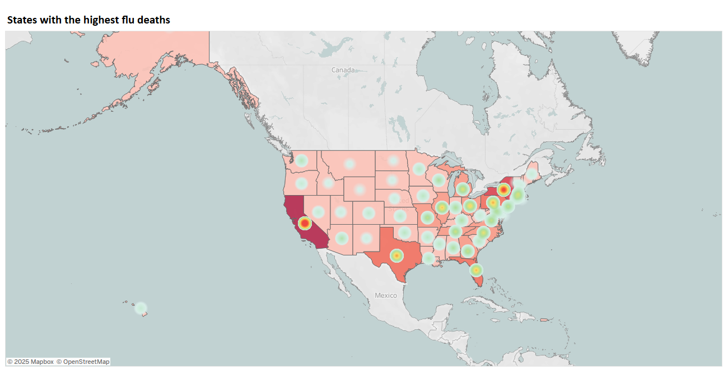
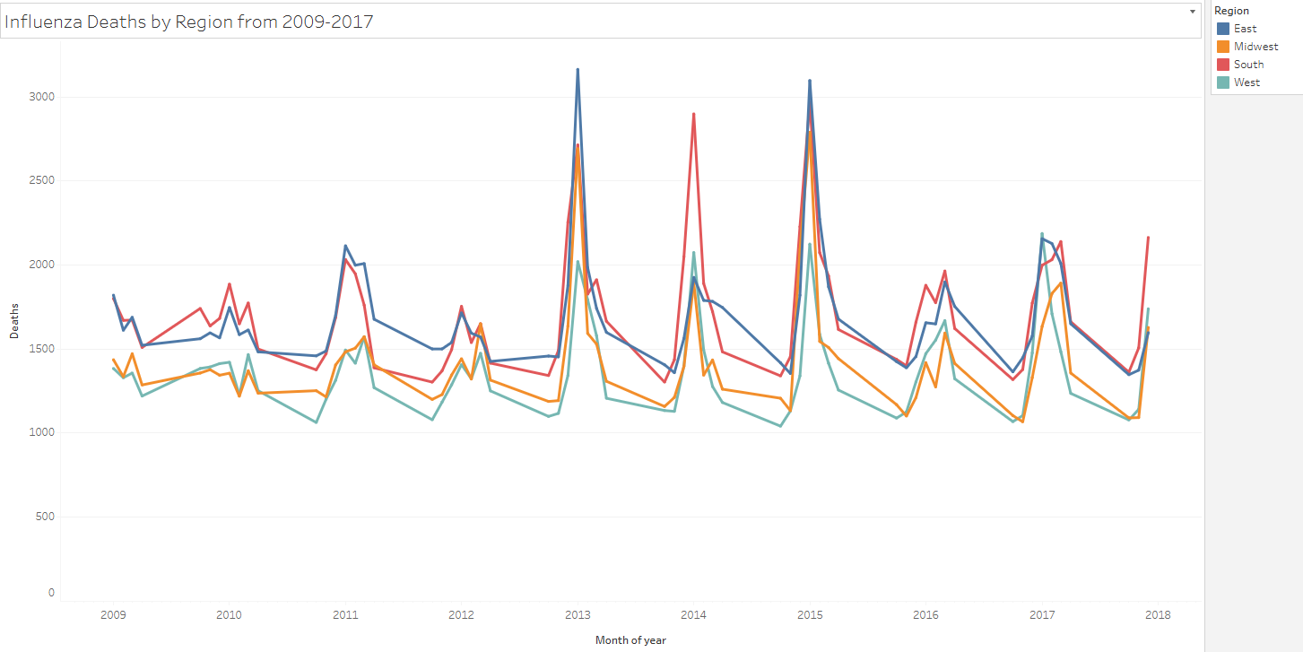
Influenza Analysis
Top 5 states with the highest deaths for age group 65+
CA
PA
FL
NY
TX
Flu season peaks from November through winter until mid April

Slide 4
Influenza Recommendations
Summary
It is determined that our highest concern is the community of the population above 65, which has the highest death count caused by the flu virus nation wide
It is found that about mid – winter and early spring are the peak flu seasons nation wide from 2009 – 2017
Recommendations
Medical staffing should be placed before the winter season for prevention and educational purposes and again in mid winter for support of the 65+ population that has caught the flu.
Increase medical staffing in the 5 states that have the highest flu death rate ( CA, PA, NY, TX, FL)
Data limitation and next steps
Public transportation and mobile clinics are necessary for vaccination for the 65+ population
Strengthen surveillance systems for timely data collection and share insights with healthcare facilities for quick responses.

